Slide 1
NBER Big Data Dinner
July 12, 2024

Slide 2
The Next Chapter of Big Data in Finance
Mao Ye
Cornell University and NBER

Slide 3
Why Next Chapter?
Thank NSF for supporting this dinner and the NBER Big Data Conferences
  Grant No. 1838183, starting from 2018
Open questions at the beginning of the grant
RFS will publish another special issue on big data
My talk is based on the introduction of the new special issue (Goldstein, Spatt, and Ye 2024)
Goldstein, Spatt, and Ye (2021)
Introduction for the RFS conference special issue for the first winter conference in 2019
Relate the seven papers in the special issue to the open questions six years ago
Make new conjecture on interesting research topics for the next chapter
Keynote at the first summer conference in 2018
Ye (2018)
Many open questions have been addressed in the past six years.

Slide 4
The Three-dimensional Definition of Big Data in Ye (2018)
Large size
  Such as tick-by-tick market microstructure data
High dimension
  A large number of variables relative to the sample size
  Machine learning is the method to deal with high-dimensional data
Complex structure
  Not in traditional row-column format
  Examples: Satellite images, social media, text, audio, video data

Slide 5
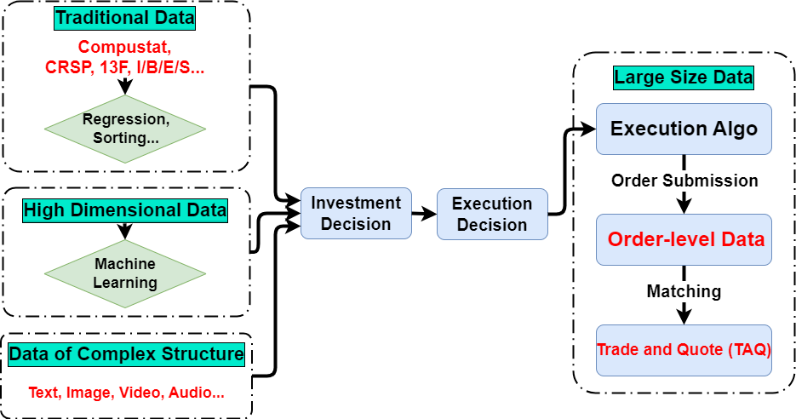
“Today, the ultimate Wall Street status symbol is a trading floor comprising Carnegie Mellon Ph.D.s, not Wharton M.B.A.s.”
-----Wall Street Journal

Slide 6
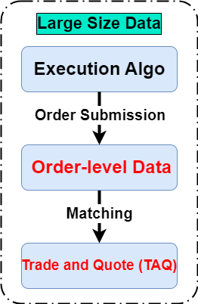
Large vs Larger
Ye (2018) called TAQ a “small” dataset because of its truncation bias
Using order-level data, O’Hara, Yao, and Ye (2014) find
  16% of trades are missing from TAQ data
    Old regulation: no need to report a trade if it is fewer than 100 shares (odd lots)
  Odd lots are the most informative trade size
    Informed traders slice large orders into odd lots to hide their information
SEC later included odd lot trades in the TAQ data
Two new research questions
  Investors can trade in increments of fewer than one share after 2019
    Da, Fang, and Lin (2024) study fractional trading
  Quotes with fewer than 100 shares are still invisible to the public
    Bartlett, McCrary, and O’Hara (2024) study the odd-lot quotes

Slide 7
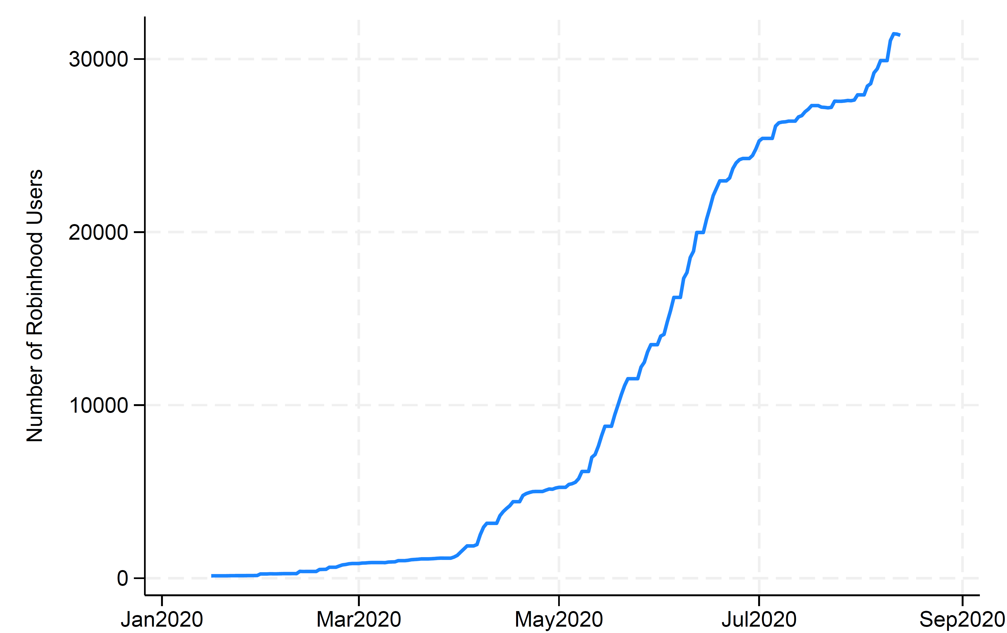
The Rise of Fractional Trading
In 2019, U.S. brokers allowed investors to buy a slice of a share with as little as a penny
Da, Fang, and Lin (2024) find that the introduction of fractional trading increases tiny trades for high-priced stocks
  Owners of Berkshire Hathaway A Shares at Robinhood

Slide 8
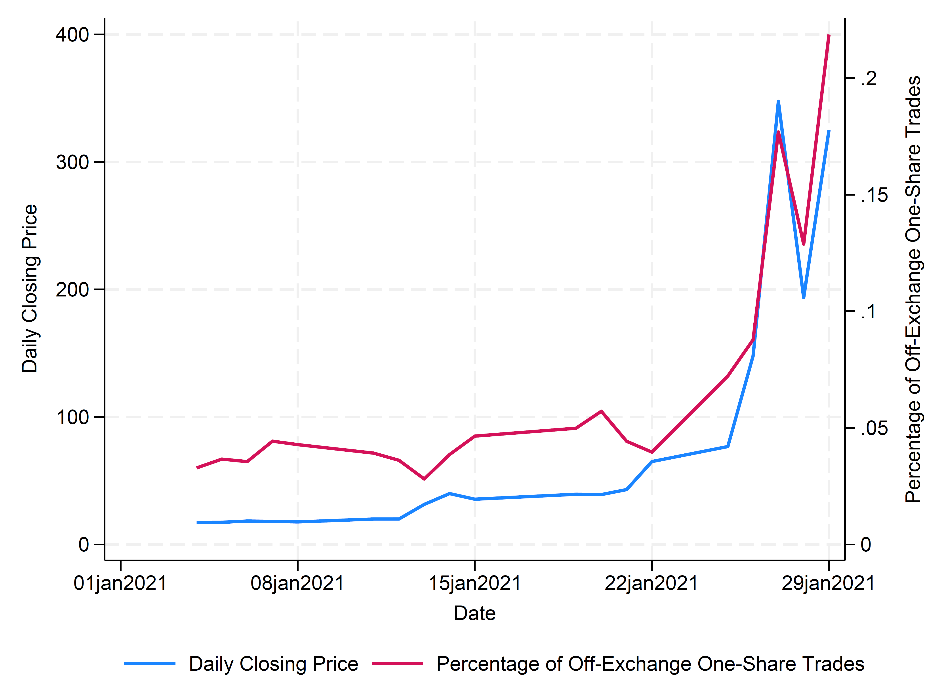
Coordinated Tiny Trades Can Lead to Large Price Pressure
Fractional Trading and GameStop Bubbles
Each trade is small but retails tend to trade in the same direction
  Fractional trading can even fuel trading frenzies and bubbles
The price pressure usually reverts later, meaning fractional trading is not informative
Smallest trades become uninformed again
  One reason: they need to be reported
But smallest quotes are still invisible

Slide 9
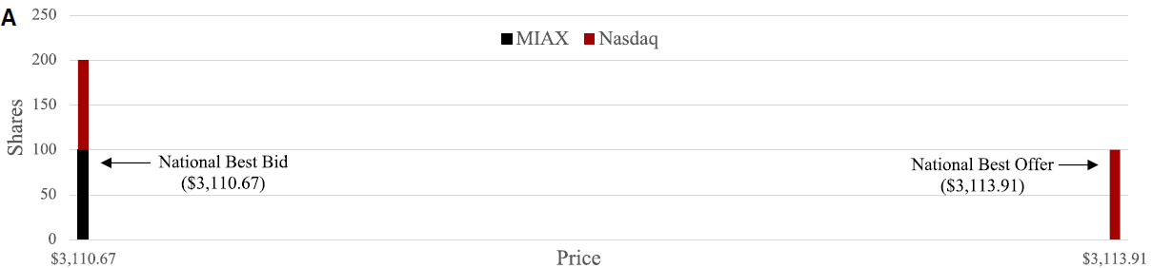
Bartlett, McCrary, and O’Hara (2024): Odd-lot Quotes
When you open your trading app, you see National Best Bid and Offer (NBBO)

Slide 10
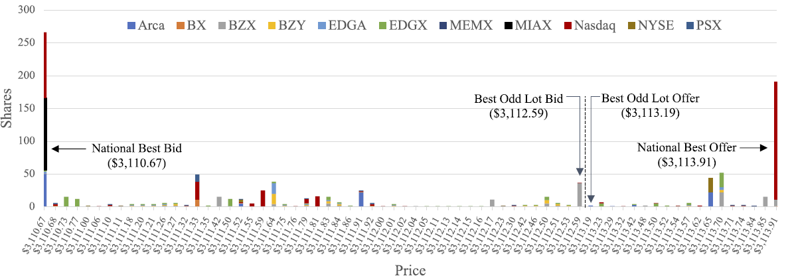
The Market Invisible to You
The odd-lot bid-ask spread is 26% smaller than NBBO spread for high-priced stocks
Odd-lot quotes are informative
  They can predict future returns, especially with machine-learning techniques
  The odd-lot quotes information is sold at very high price

Slide 11
Open Questions
Current U.S. regulations are mostly designed for humans, not machines
  Academic research helps to inform public policy in the era of machines and big data
SEC Chair Gary Gensler’s four proposals on market structure
  Tick size and Access Fees and the Transparency of Better Priced Orders
    Reduce lot size below 100 shares, reduce tick size below 1 cent, and reduce trading fees
  Enhance Competition for Individual Investor Order Execution
    Impose order-by-order competition for trading against retail orders.
    Ernst, Spatt, and Sun (2024) predict it is a bad idea. The question is, what is a good idea?
  Regulation Best Execution
  Final rule for Disclosure of Order Execution Information
Policy implementations provide shocks to study other questions
  When NYSE allowed firms to use computer algorithms to buy back their shares, share repurchases increase by 25% (Li, Zheng, and Ye 2024)
  Market structure innovations explain 18% of the secular increase in share repurchases since 1994

Slide 12
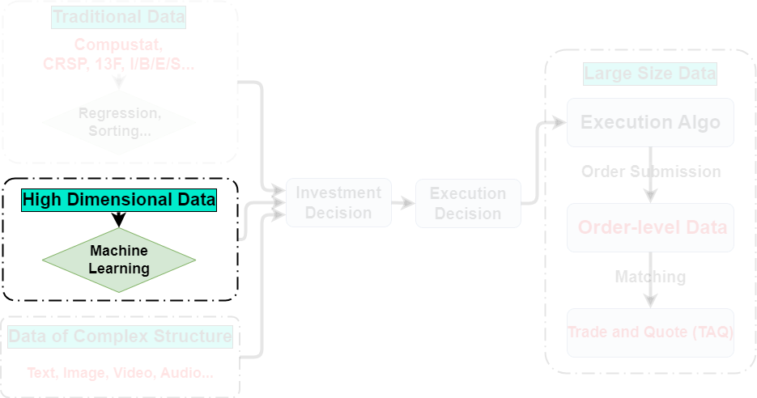

Slide 13
High Dimension: Variables vs Functional Classes
High dimension in variables
  More variables than observations in Chinco, Clark-Joseph, and Ye (2019)
    Predict returns of individual stocks
    Forecast one-minute-ahead return in rolling 30-minute windows using LASSO
    Variables: the lagged return of the stock plus 2000 other stocks
High dimension in functional classes
  Fewer predictors, but the non-linear interactions among variables lead to high dimensionality
  Aleti and Bollerslev (2024)
    Predict the return of the Stochastic Discount Factor (SDF)
    Use neural networks to flexibly approximate the unknown functional form of the SDF
Despite their differences, both papers follow the same two steps
  Use machine learning to predict returns
  More importantly, give economic intuition of the return predictions

Slide 14
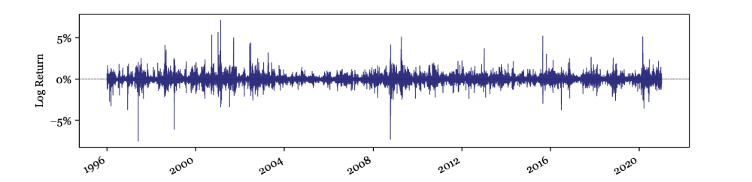
1. Use Machine Learning to Predict Return
Start from the 15-minute returns of 272 portfolios
  218 from Chen and Zimmermann (2021)
  48 industry portfolios
  Six Fama-French portfolios
The estimated SDF aims to minimize the largest possible squared pricing errors
  Identify returns exceeding three standard deviations as jumps

Slide 15
    2. Link the Jumps with News
SDF rarely jumps without news
  Cutler, Poterba, and Summers (CSP 1989) found the opposite
    CSP found that large market moves often occur without any identifiable major news
  Two differences
    Return data: CSP (1989) used daily data, whereas this paper uses minute-level data
      Fair (2002) found 53/69 events can be identified when using minute-level return data
      Still, many large stock price changes have no events associated with them
    News data
      CSP (1989) read the next day’s New York Times by themselves
      Aleti and Bollerslev (2024) uses real-time machine-readable news (50,879,472 articles)
News related to monetary policy and finance accounts for most of the variation in the SDF
Much of the priced monetary policy news is unscheduled
  Chinco, Clark-Joseph, and Ye (2019) find unscheduled news is the main driver for individual stock returns

Slide 16
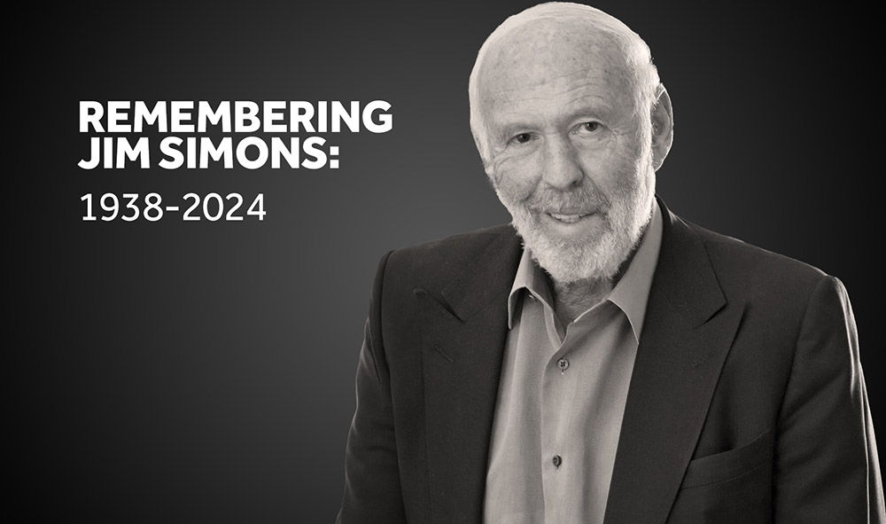
Promising Lines of Research:
Investors Who Are Too Slow for Market Microstructure and Too Fast for Asset Pricing
Microseconds
1 Months
Market microstructure
High-frequency traders
Asset Pricing
Traditional funds
There is one goat [greatest of all time] His name was Jim Simons
- Clifford Asness
co-founder of AQR
They are the most natural users of machine learning techniques
Their horizon is “anywhere from a few minutes to a few months.” (WSJ)
Despite their increase in importance, we have a limited understanding of this lost horizon
  The two papers provide some insights on the minute horizon, but there is still a long way to fill in the gap
  How about hourly, daily, and weekly horizons?
Just like psychology builds the foundation for behavioral finance, machine learning may build the foundation for algorithmic behavioral finance

Slide 17
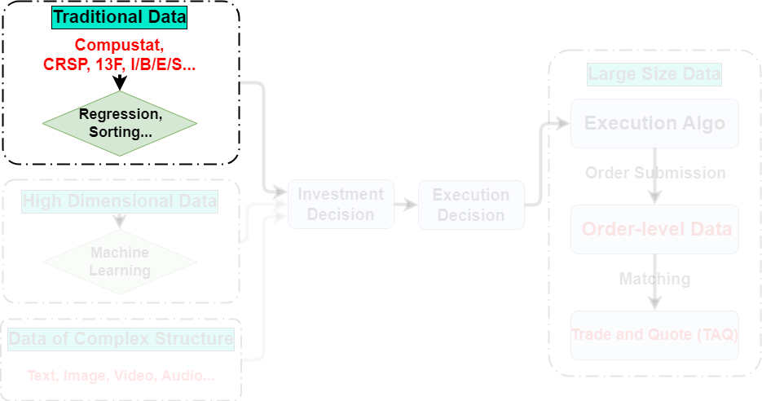
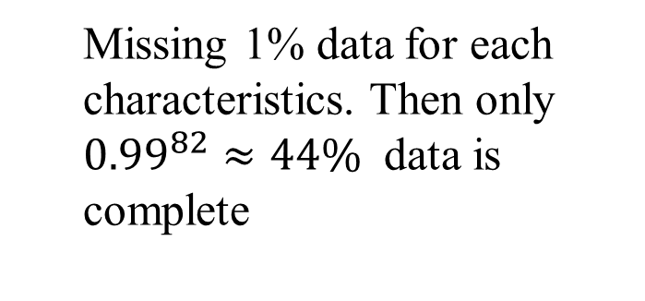
High Dimension Can Lead to Missing Data Problem
  Missing 1% data for each characteristics. Then only ${0.99}^{82}≈44\%$ data is complete

Slide 18
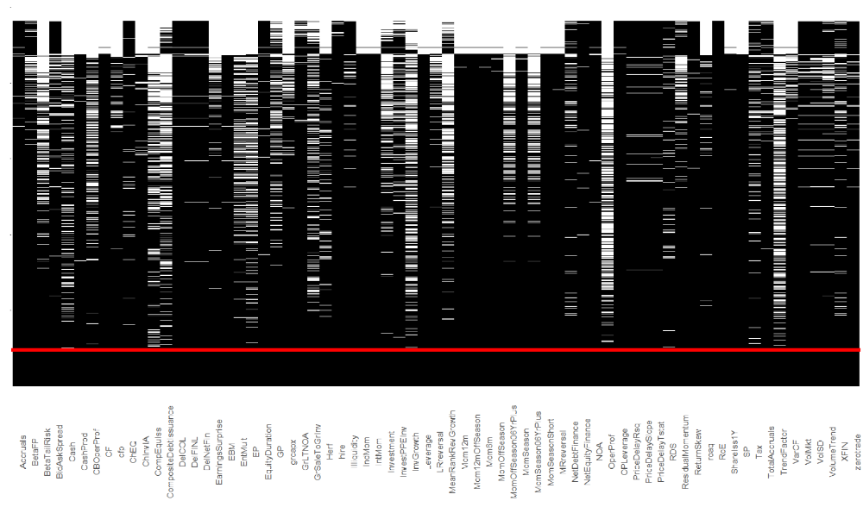
Missing Stock Characteristics for Monthly Return Predictions
Only 10% of observations are complete in Freyberger et al (2024)
Freyberger et al (2024)
  Use conditional means
Bryzgalova et al. (2024)
  Use a factor model
I will give you a very general example for a dinner talk
82 Stock characteristics in Freyberger et al (2024)

Slide 19
Missing Grades in My Course
ID | PS 1 | PS 2 | Midterm | Final
1 |  | 5 | 39 | 63
2 | 10 | 10 | 77 | 87
3 | 9.5 | 6 |  | 63
4 | 8.5 |  | 54 | 66
5 | 10 | 8 | 94 | 92
6 |  | 8 | 49 | 11
7 | 10 | 8 | 89 | 99
8 | 8.5 | 8 | 77 | 85
9 | 10 | 8.5 | 83 | 85
10 | 7.5 | 9 |  | 87
11 | 10 | 8 | 71 | 93
12 | 10 |  | 93 | 92
13 |  | 9.5 | 88 | 94
14 | 10 | 9.5 | 68 | 78
Suppose student 10 misses the midterm exam for a legitimate reason
Suppose grades are missing at random after controlling for observed characteristics

Slide 20
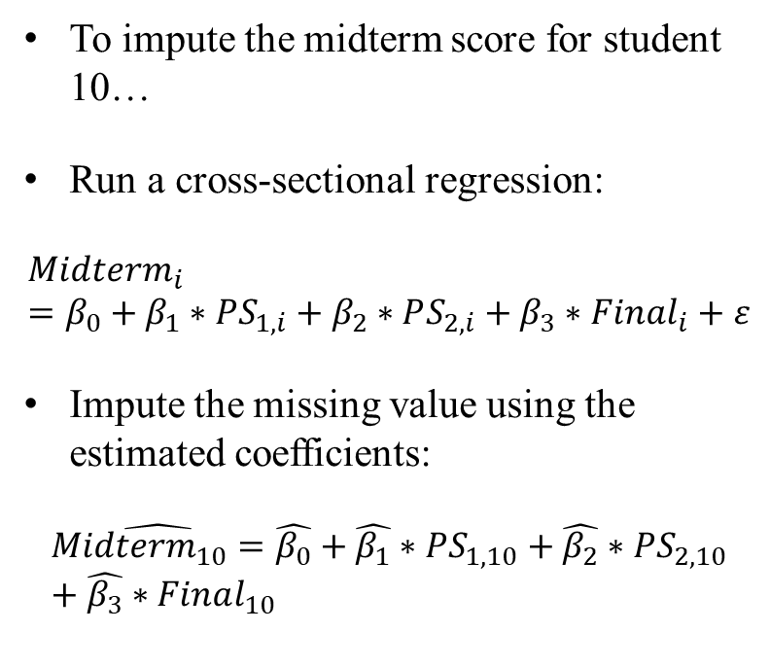
Conditional Mean Approach (Freyberger et al. 2024)
ID | PS 1 | PS 2 | Midterm | Final
1 |  | 5 | 39 | 63
2 | 10 | 10 | 77 | 87
3 | 9.5 | 6 |  | 63
4 | 8.5 |  | 54 | 66
5 | 10 | 8 | 94 | 92
6 |  | 8 | 49 | 11
7 | 10 | 8 | 89 | 99
8 | 8.5 | 8 | 77 | 85
9 | 10 | 8.5 | 83 | 85
10 | 7.5 | 9 |  | 87
11 | 10 | 8 | 71 | 93
12 | 10 |  | 93 | 92
13 |  | 9.5 | 88 | 94
14 | 10 | 9.5 | 68 | 78
To impute the midterm score for student 10…
Run a cross-sectional regression:
$$Midte{rm}_{i}=β_{0}+β_{1}∗PS_{1,i}+β_{2}∗PS_{2,i}+β_{3}∗Final_{i}+ε$$
Impute the missing value using the estimated coefficients:
$$\hat{Midterm_{10}=}\hat{β_{0}}+\hat{β_{1}}∗PS_{1,10}+\hat{β_{2}}∗PS_{2,10}+\hat{β_{3}}∗Final_{10}$$
Notes:
Removed arrow

Slide 21
Factor Analysis (Bryzgalova et al. 2024)
Covariance using students who have both scores:
Use PCA to find factors representing these relations
I find two strong factors in my score data
  “Exam factor”
  “Homework factor”
The imputation is very intuitive
  Do not impute exam score using homework score
  Use the score from another exam
ID | Normalized PS1 | Normalized PS 2 | Normalized Midterm | Normalized Final
1 |  | -0.35 | -0.35 | -0.42
2 | 0.04 | 0.50 | 0.04 | 0.04
3 | -0.04 | -0.27 |  | -0.42
4 | -0.19 |  | -0.19 | -0.27
5 | 0.04 | -0.19 | 0.50 | 0.19
6 |  | -0.19 | -0.27 | -0.50
7 | 0.04 | -0.19 | 0.35 | 0.50
8 | -0.19 | -0.19 | 0.04 | -0.12
9 | 0.04 | 0.19 | 0.19 | -0.12
10 | -0.27 | 0.27 |  | 0.04
11 | 0.04 | -0.19 | -0.04 | 0.35
12 | 0.04 |  | 0.42 | 0.19
13 |  | 0.35 | 0.27 | 0.42
14 | 0.04 | 0.35 | -0.12 | -0.19
 | PS 1 | PS 2 | Midterm | Final
PS 1 | 0.0826 | 0.1184 | 0.0454 | 0.0334
PS 2 | 0.1184 | 0.1342 | 0.0003 | 0.0277
Midterm | 0.0454 | 0.0003 | 0.1278 | 0.0885
Final | 0.0334 | 0.0277 | 0.0885 | 0.1054

Slide 22
Open Questions: Missing Not at Random (MNAR)
MNAR: missing probability depends on missing variables even after controlling observables
  Students who miss an exam are more likely to fail the exam
  Firms that do not have an ESG rating may have more extreme values for ESG
Little and Rubin (2019) introduce many statistical methods to deal with MNAR
Our task is to use our knowledge in finance to justify the assumed missing mechanisms
  One analogy: instrumental variable approach (IV)
  Finance researchers do not invent the IV approach, but we find many creative instruments
Similarly, machine learning would not replace our domain knowledge in finance
  Instead, new methods and our domain knowledge complement each other.

Slide 23
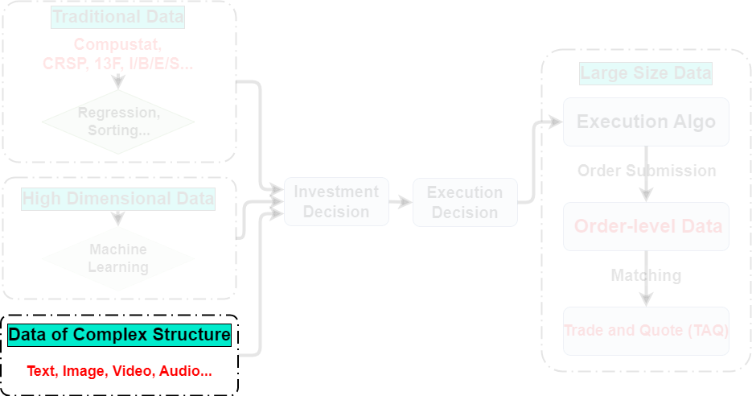

Slide 24
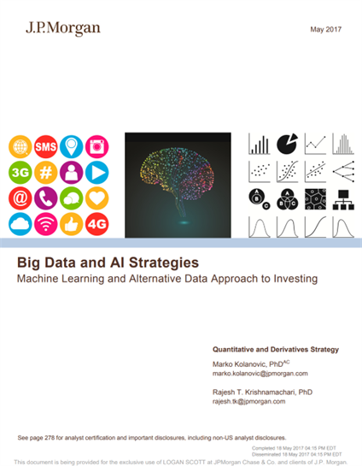
Unstructured Data
Two ways to transform unstructured data:
  Find a vendor of alternative data or use data provided by other researchers
  Transform the data by yourself
Hirshleifer, Peng, and Wang (2024) use both approaches
  An excellent example of the pros and cons of each approach
Finding: firms in higher-centrality counties have lower post-earning announcement drift
  Reason: faster information diffusion among investors

Slide 25
Two Unstructured Datasets
The main measure of centrality comes from Bailey et al. (2018)
  The Social Connectedness Index (SCI) constructed from Facebook
  Pros: Comprehensive
  Cons: they are designed for Bailey et al. (2018) but not Hirshleifer, Peng, and Wang (2024)
    Hirshleifer, Peng, and Wang (2024) only have a snapshot of the SCI in 2016
They create time-varying measures of centrality based on StockTwits influencers
  Pros: allow Hirshleifer, Peng, and Wang (2024) to control for firm fixed effects
  Cons: Less representative coverage
StockTwits also allows them to measure disagreement for tests about trading volume
  Facebook data cannot
  New insight: Online social interactions associated with persistent opinion polarization
    Da et al. (2018) study information diffusion in social media but they cannot measure disagreement
Notes:
Removed social churning

Slide 26
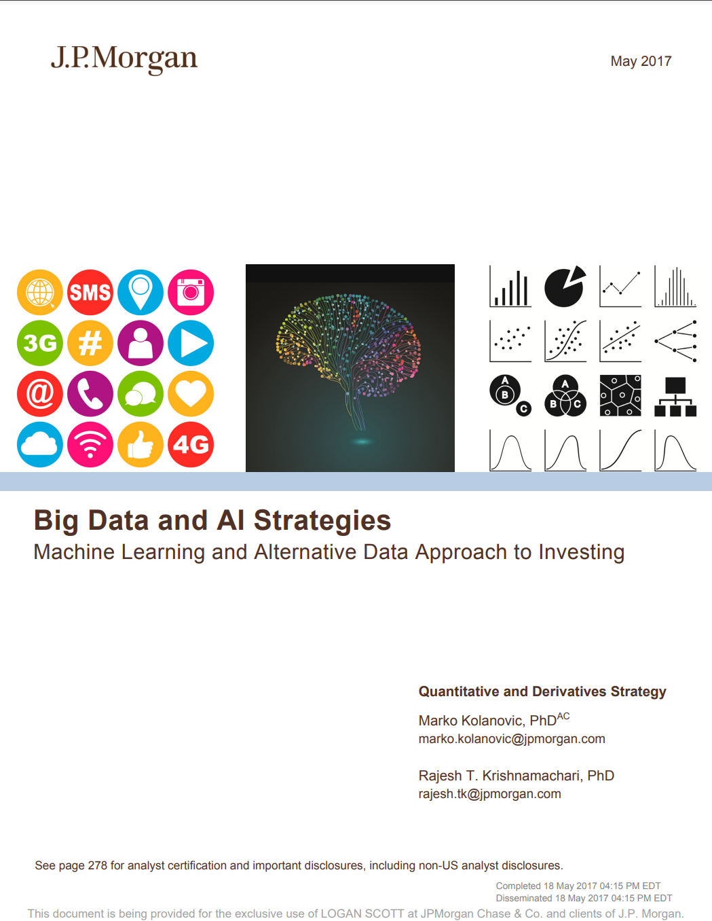
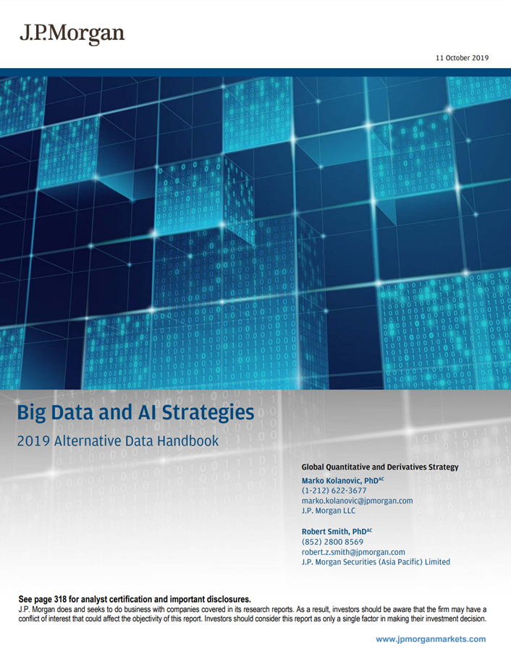
More Resources for Unstructured Data

Slide 27
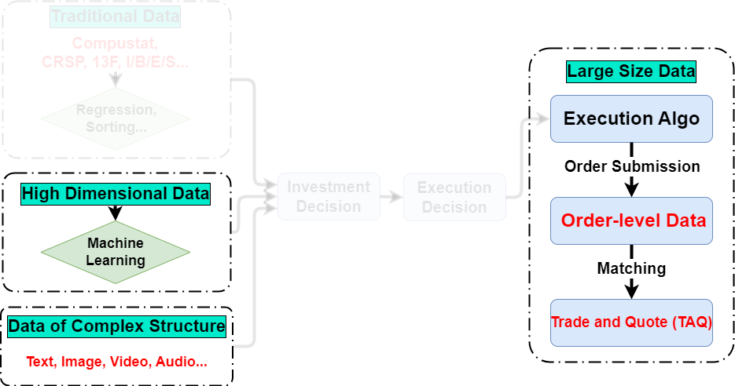
Open Question in Goldstein, Spatt, and Ye (2021):
What is the Price of the Data?

Slide 28
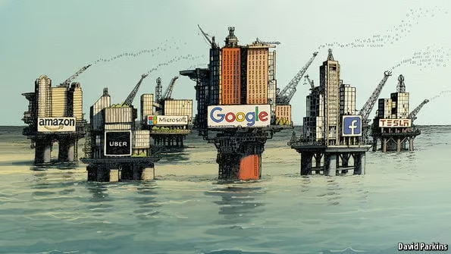
An Initial Step to Value the Data: Farboodi et al. (2024)
Two simplifications
  Financial but not other industry
  Demand but not supply
    Investor’s willingness to pay but not the equilibrium price
Still a daunting task because the data value depends on
  The characteristics of other investors
  Who else has the data
  Existing data
“The World’s Most Valuable Resource Is No Longer oil, but Data”
---The Economist

Slide 29
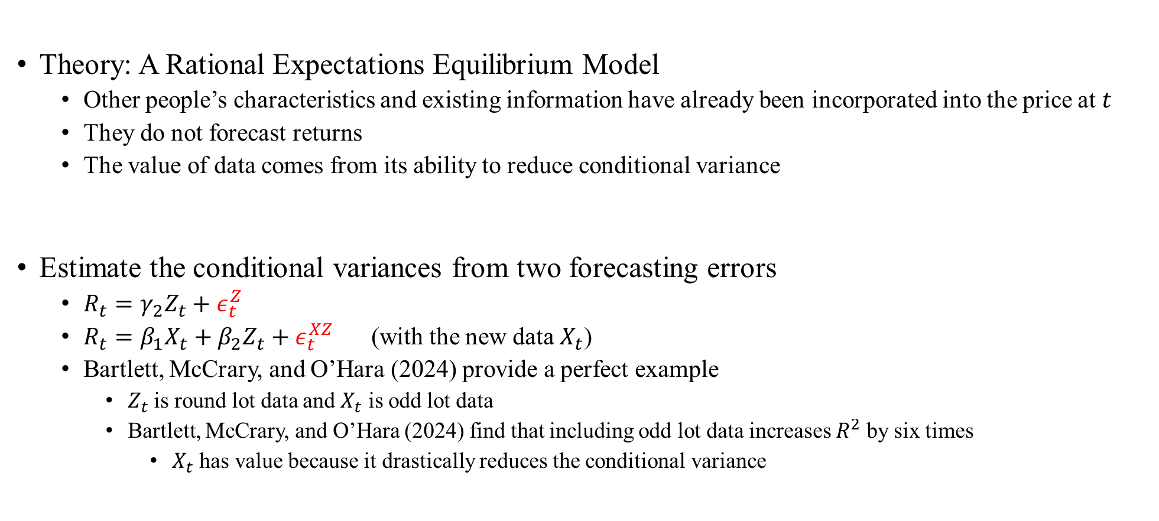
Conditional Variance Provides Sufficient Statistics to Value Data
Theory: A Rational Expectations Equilibrium Model
  Other people’s characteristics and existing information have already been incorporated into the price at $t$
  They do not forecast returns
  The value of data comes from its ability to reduce conditional variance
Estimate the conditional variances from two forecasting errors
  $R_{t}=γ_{2}Z_{t}+ε_{t}^{Z}$
  $R_{t}=β_{1}X_{t}+β_{2}Z_{t}+ε_{t}^{XZ}$ (with the new data $X_{t}$)
  Bartlett, McCrary, and O’Hara (2024) provide a perfect example
    $Z_{t}$ is round lot data and $X_{t}$ is odd lot data
    Bartlett, McCrary, and O’Hara (2024) find that including odd lot data increases $R^{2}$ by six times
      $X_{t}$ has value because it drastically reduces the conditional variance

Slide 30
Open Questions
Farboodi et al. (2024) | Open Questions
Data Demand | Data supply Data price, after you know both data demand and supply
Financial data | Non-financial data Veldkamp (2023) proposes six possible approaches to value data, but the literature is sparse
Private value of the data | Social value of the data
Price efficiency | Whether data help real efficiency Bond, Edmans, and Goldstein (2012)

Slide 31
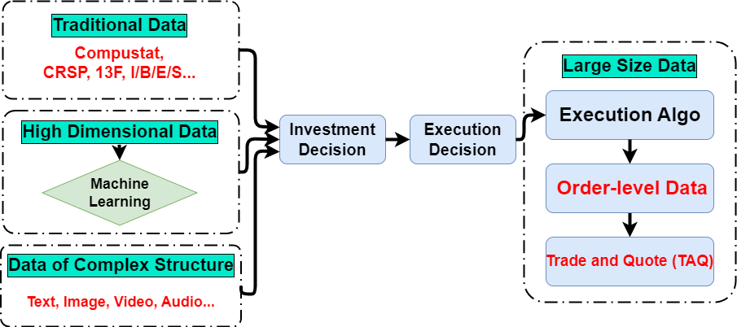
Conclusion: How and Why
We should embrace big data
  Especially when many players in financial markets are not from finance backgrounds
  They know how
We will not be replaced by AI and big data
  Because once we know how, we will also know why

